Slide 1


Chapter Six
Labour Demand, Nonwage Benefits, and Quasi-Fixed Costs
Prepared by Dr. Mir Ahasan Kabir
York University

Slide 2
Learning Objectives
Outline the concept of quasi-fixed costs of labour, explaining how, unlike wages and salaries, these are costs a firm must pay regardless of the number of hours worked by each employee.
Discuss the distinction between workers and hours as components of the labour input, and outline the potential insights gained from this perspective.
Discuss the importance of non-wage benefits as a share of total compensation, and how these non-wage benefits affect the way we model labour demand.
Describe how quasi-fixed costs create a wedge between the value of the marginal product and the wage rate, and the implications of this for labour hoarding and other dynamic decisions of the firm.
© 2021 MCGRAW-HILL EDUCATION LTD.
6 - <number>

Slide 3
Main Questions
Many payroll taxes (such as employer contributions to unemployment insurance) have ceilings, or maximum payments per worker. How can this feature of payroll taxes actually reduce employment?
Why is less-expensive, unskilled labour more likely to be laid off during a downturn than more-expensive, skilled labour?
Can restrictions on the length of the workweek or the amount of overtime permitted lead to the creation of more jobs for others?
Did short-time work schemes and other worksharing programs helped save jobs during the Great Recession of 2008–2009?
© 2021 MCGRAW-HILL EDUCATION LTD.
6 - <number>

Slide 4
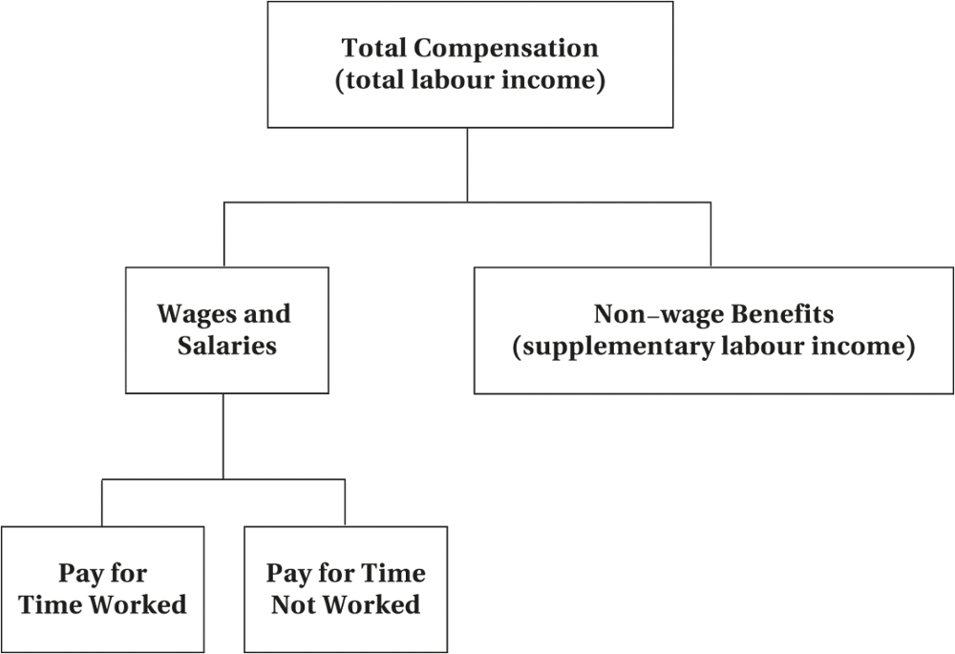
Non-wage Benefits and Total Compensation
Figure 6.1 Components of Total Compensation
© 2021 MCGRAW-HILL EDUCATION LTD.
6 - <number>

Slide 5
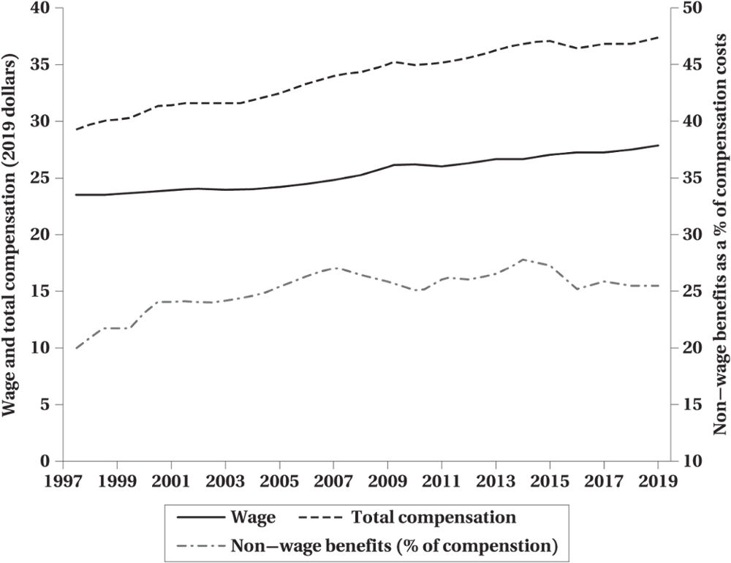
Non-wage Benefits and Total Compensation
Figure 6.2 Total Compensation, Wage, and Non-wage benefits
© 2021 MCGRAW-HILL EDUCATION LTD.
6 - <number>

Slide 6
Non-wage Benefits and Total Compensation
Unconditional Cash Transfers vs. Transfers-In-Kind
Employee Benefits
  Taxes
  Group purchase
  Adverse selection
Employer Benefits
  Production planning
  Deferred compensation
© 2021 MCGRAW-HILL EDUCATION LTD.
6 - <number>

Slide 7
Quasi-Fixed Labour Costs
Independent of the number of hours worked
Arise from:
  Hiring costs
  Training costs
  Dismissal costs
  Nonwage benefits
© 2021 MCGRAW-HILL EDUCATION LTD.
6 - <number>

Slide 8
Quasi-Fixed Labour Costs
Variable labour costs:
  Vary with hours
Quasi-fixed:
  Incurred per employee
  Independent of hours
© 2021 MCGRAW-HILL EDUCATION LTD.
6 - <number>

Slide 9
Quasi-Fixed Labour Costs
Recurring
  Payroll taxes
Nonrecurring
  Hiring and orienting new employees
  Dismissing employees
© 2021 MCGRAW-HILL EDUCATION LTD.
6 - <number>

Slide 10
Quasi-Fixed Labour Costs
General Effect of Quasi-Fixed Costs
Increase in the MC of hiring an additional worker relative to MC of working an existing worker longer hours
Discourage labour expansion away from employment and toward working more hours
Hiring continues until the present value of additional future revenues = the present value of additional costs
© 2021 MCGRAW-HILL EDUCATION LTD.
6 - <number>

Slide 11
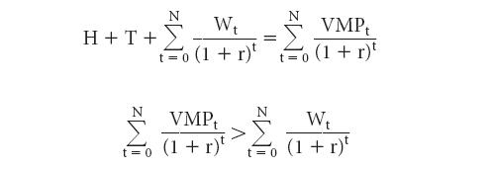
Quasi-Fixed Labour Costs
Profit-Maximizing Employment Rule
Where, H + T = hiring and training costs
W_{t} = wage rate in period t
R = discount rate
N = expected length of employment rate
MRP_{t} (VMP_{t}) = the expected value of the marginal product
© 2021 MCGRAW-HILL EDUCATION LTD.
6 - <number>

Slide 12
Quasi-Fixed Labour Costs
WORKED EXAMPLE
Quasi-fixed Costs and Training
 | Costs
Employment Duration (N) | Fixed (H + T) | Variable (ΣW_{t}) | Total | Benefits (ΣVMP_{t}) | Total Profit | Yearly Profit
1 year | $15,000 | $25,000 | $40,000 | $30,000 | −$10,000 | −$10,000
2 years | 15,000 | 50,000 | 65,000 | 60,000 | −5,000 | −2,500
3 years | 15,000 | 75,000 | 90,000 | 90,000 | 0 | 0
4 years | 15,000 | 100,000 | 115,000 | 120,000 | 5,000 | 1,250
5 years | 15,000 | 125,000 | 140,000 | 150,000 | 10,000 | 2,000
© 2021 MCGRAW-HILL EDUCATION LTD.
6 - <number>

Slide 13
Some Phenomena Explained by Fixed Costs
Overtime
Temporary help agencies
Layoffs
Segmentation of labour markets
Resistance to work-sharing
© 2021 MCGRAW-HILL EDUCATION LTD.
6 - <number>

Slide 14
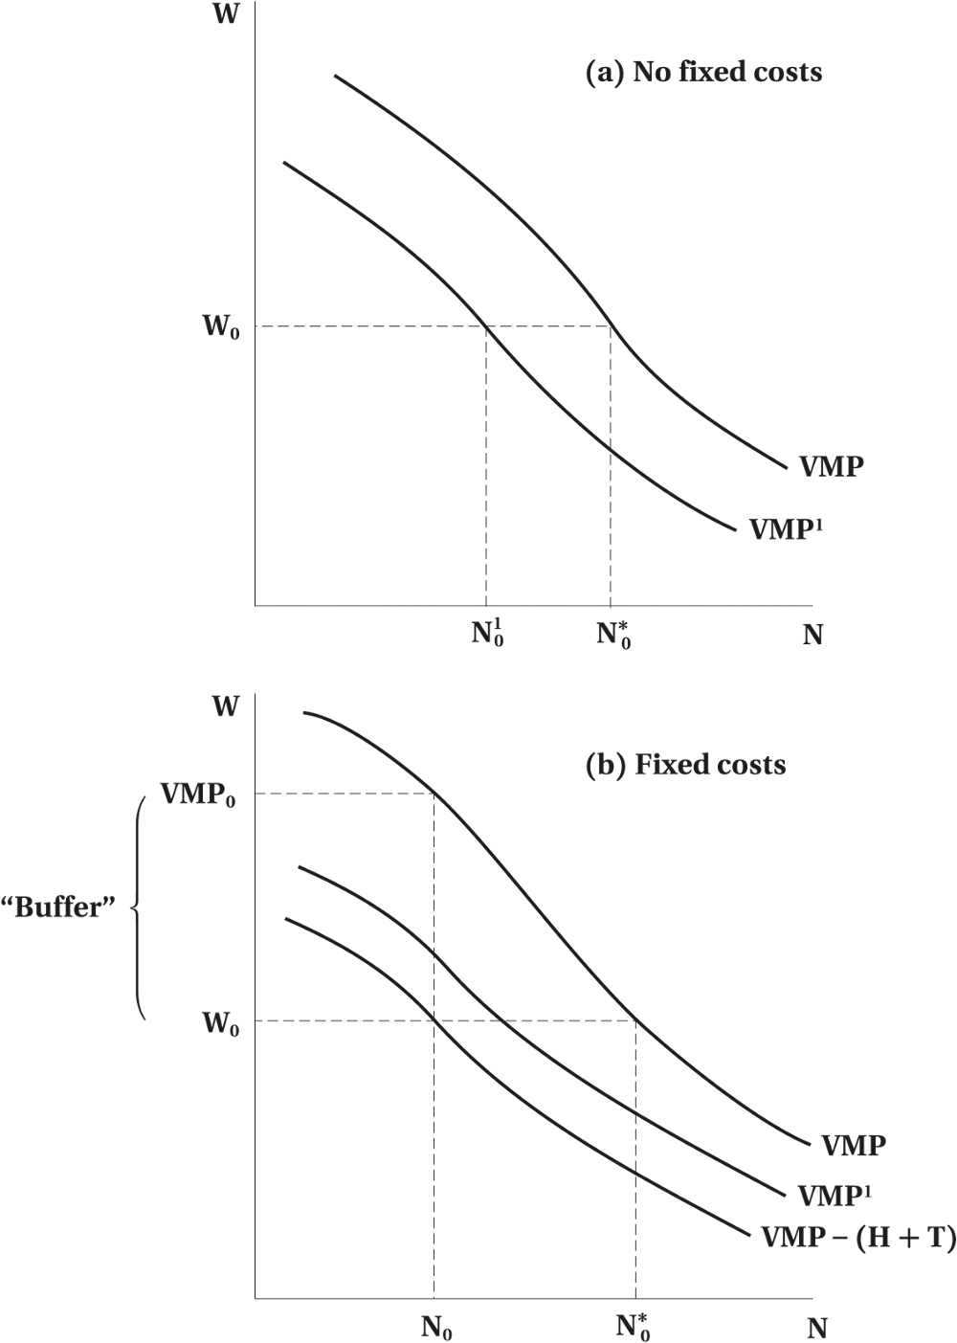
Some Phenomena Explained by Fixed Costs
Figure 6.3 Nonrecurring Fixed Employment Costs and Changes in Labour Demand
© 2021 MCGRAW-HILL EDUCATION LTD.
6 - <number>

Slide 15
Worksharing and Job Creation
Overtime Restrictions and Job Creation
  Nonwage Benefit and Part-time work
  Short-time Work and the Great Recession of 2008—2009
Subsidizing Employment Sharing
Workers and the Demand for Worksharing
© 2021 MCGRAW-HILL EDUCATION LTD.
6 - <number>

Slide 16
Chapter Summary
Labour compensations and nonwage benefits
Quasi-fixed costs of employment
The “extensive” vs. “intensive” margins of additional employment hours
Quasi-fixed costs and a wedge between the VMP of labour and the wage rate
Labour cost and worksharing programs
© 2021 MCGRAW-HILL EDUCATION LTD.
6 - <number>

